Slide 1

Exploratory Data Analysis

Slide 2
Objectives
Exploratory Data Analysis
Implement descriptive statistics
Demonstrate the basics of grouping
Exploratory Data Analysis

Slide 3
Exploratory Data Analysis- EDA
EDA is an approach to analyze data in order to:
  Summarize main characteristics of the data
  Gain a better understanding of the data set
  Uncover relationships between different variables
  Extract important variables for the problem we're trying to solve.
The main question for car price predict problem:
  What are the characteristics that have the most impact on the car price?
Exploratory Data Analysis

Slide 4
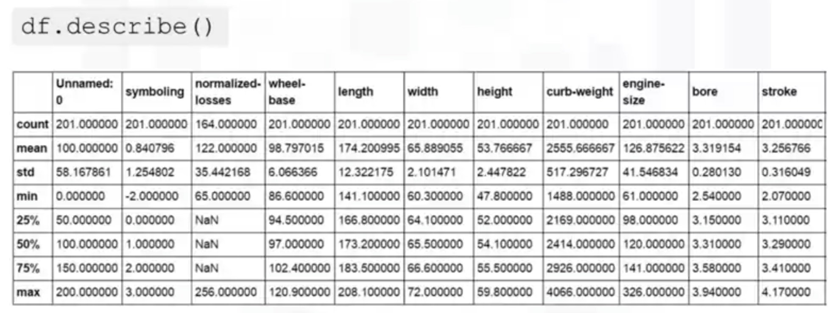
Descriptive Statistics
It’s important to first explore your data before you spend time building complicated models
Descriptive statistical analysis helps to describe basic features of a data set
df.describe(): summarize statistics
Exploratory Data Analysis

Slide 5
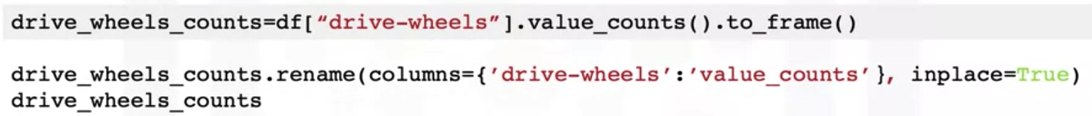
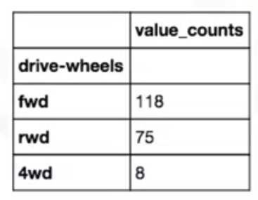
Descriptive Statistics
value_count(): Summarize the categorical data
summarize the categorical data:
  118 cars in the front wheel drive category.
  75 cars in the rear wheel drive category
  8 cars in the four wheel drive category
Exploratory Data Analysis

Slide 6
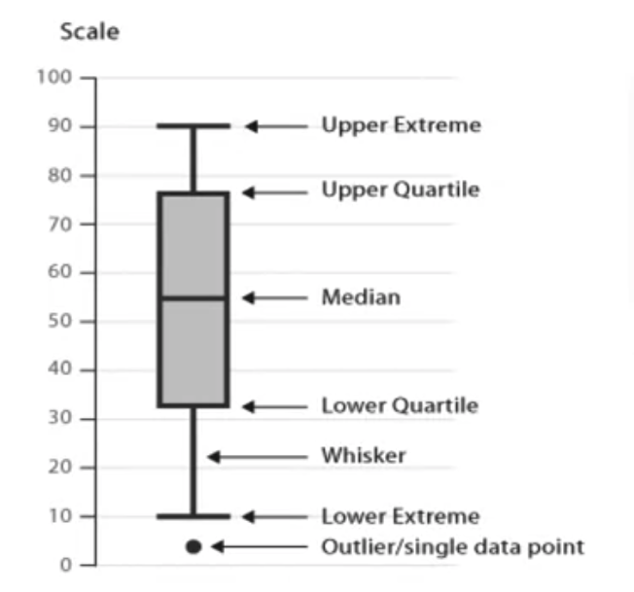
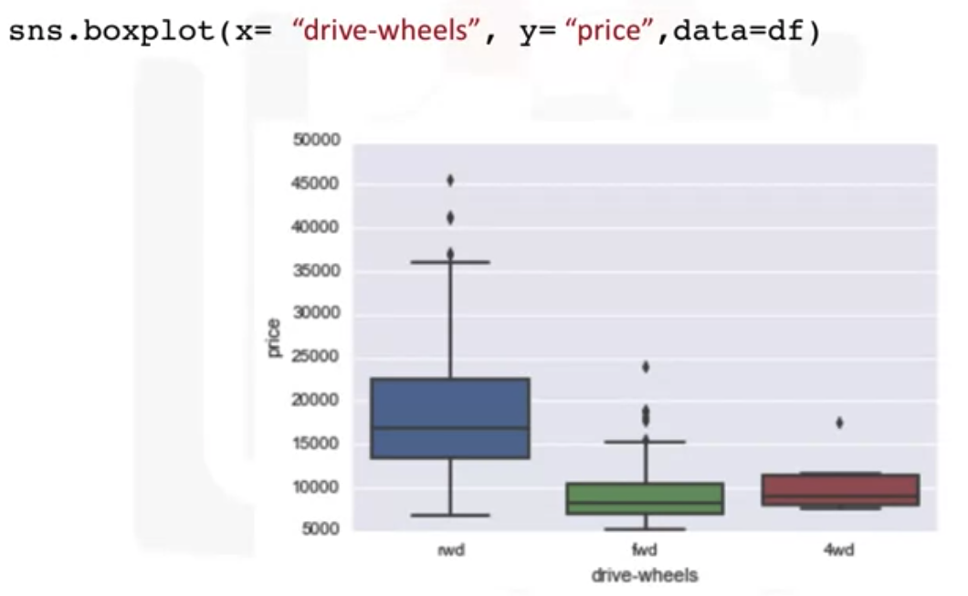
Descriptive Statistics
Box plots are a great way to visualize numeric data
Give your opinion about this chart!
Exploratory Data Analysis

Slide 7
Descriptive Statistics
Box plots make it easy to compare between groups.
We can see the distribution of different categories of the drive wheels feature over the price feature.
The distribution of price between the rear-wheel drive, and the other categories are distinct.
The price for front-wheel drive and four-wheel drive are almost indistinguishable.
Exploratory Data Analysis

Slide 8
Descriptive Statistics
What if we want to understand the relationship between engine size and price→ Could engine size possibly predict the price of a car?
One good way to visualize this is using a scatter plot.
Each observation in the scatter plot is represented as a point. This plot shows the relationship between two variables.
  The predictor variable is the variable you use to predict an outcome.
  The target variable is the variable that you are trying to predict
Exploratory Data Analysis

Slide 9
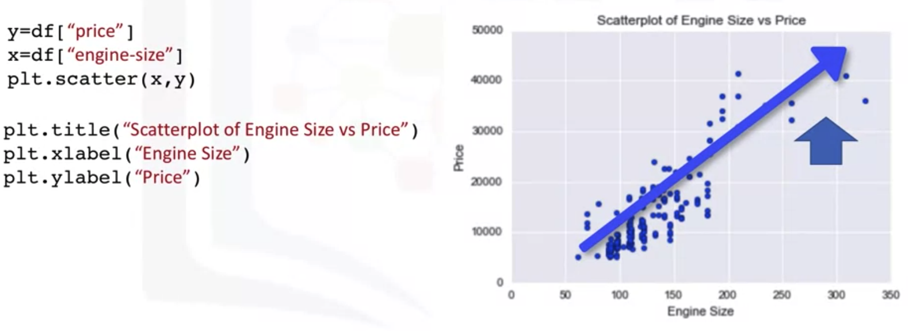
Descriptive Statistics
linear relationship between these two variables
Exploratory Data Analysis

Slide 10
Group By in Python
Problem:
  Is there any relationship between the different types of drive system, forward, rear, and four-wheel drive, and the price of the vehicles
  If so, which type of drive system adds the most value to a vehicle?
Student gives the answers
Exploratory Data Analysis

Slide 11
Group By in Python
Problem:
  Is there any relationship between the different types of drive system, forward, rear, and four-wheel drive, and the price of the vehicles
  If so, which type of drive system adds the most value to a vehicle?
Solution: we could group all the data by the different types of drive wheels and compare the results of these different drive wheels against each other.
df.groupby(): grouping data
  Can be applied on categorical variables
  Group data into categories
  Single or multiple variables
Exploratory Data Analysis

Slide 12
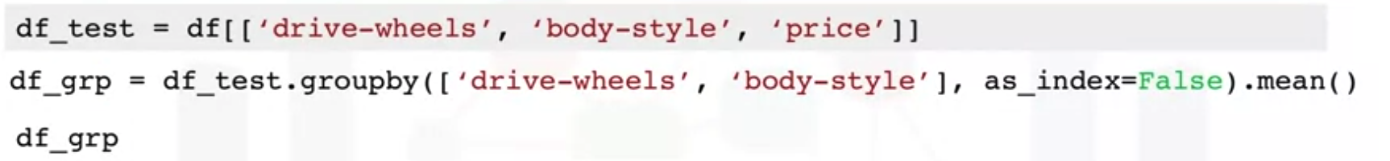
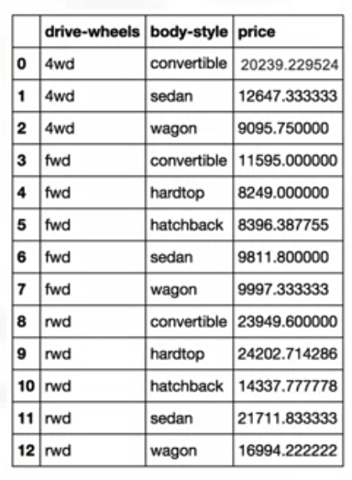
Group By in Python
Exploratory Data Analysis

Slide 13
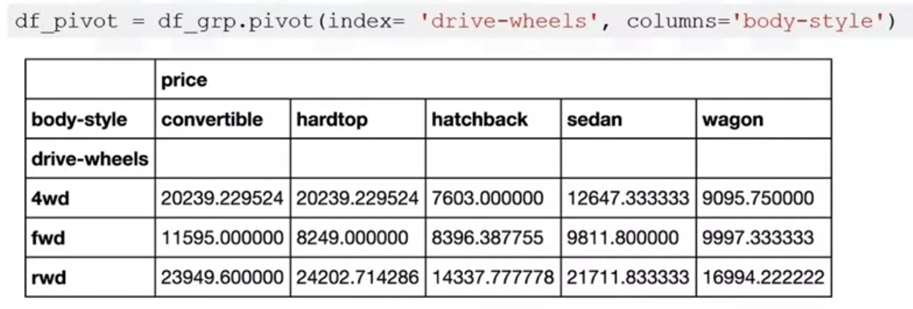
Group By in Python
pivot(): one variable displayed along the columns and the other variable displayed along the rows
Exploratory Data Analysis

Slide 14
Group By in Python
Heat map takes a rectangular grid of data and assigns a color intensity based on the data value at the grid points.
It is a great way to plot the target variable over multiple variables and through this get visual clues with the relationship between these variables and the target.
Exploratory Data Analysis

Slide 15
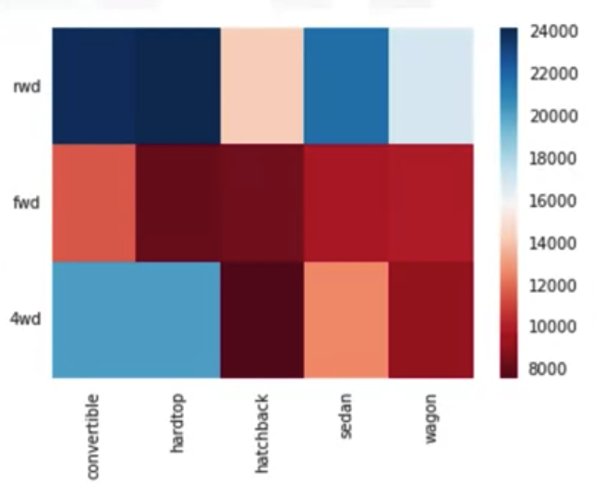

Group By in Python
Each type of body style is numbered along the x-axis and each type of drive wheels is numbered along the y-axis.
The average prices are plotted with varying colors based on their values.
The top section of the heat map seems to have higher prices than the bottom section.
Exploratory Data Analysis

Slide 16
Summary
Exploratory Data Analysis
Implement descriptive statistics
Demonstrate the basics of grouping
Exploratory Data Analysis

Slide 17
Q & A
Exploratory Data Analysis

